Slide 1


Slide 2
Study 3: Manipulating Affect Valuation Through Interpersonal Goals
Participants
  15 European American female dyads
  15 Asian American female dyads
  20 Hong Kong Chinese female dyads
Conditions
  1. Influence Partner (“Leader”)
  2. Adjust to Partner (“Matcher”)
Procedure
  Begin joint pattern-matching task
  Complete real and ideal affect measure
  3. Finish task
  4. Complete interpersonal goals measure
FELICITY MIAO

Slide 3
“Influence” Goals
(Locke, 2000)
They listen to what I have to say.
They show me respect.
They respect what I have to say.
They respect my privacy.

Slide 4
“Adjustment” Goals
(Locke, 2000)
They not see me as getting in their way.
They not get their feelings hurt.
I do what they want me to do.
I go along with what they want me to do.

Slide 5
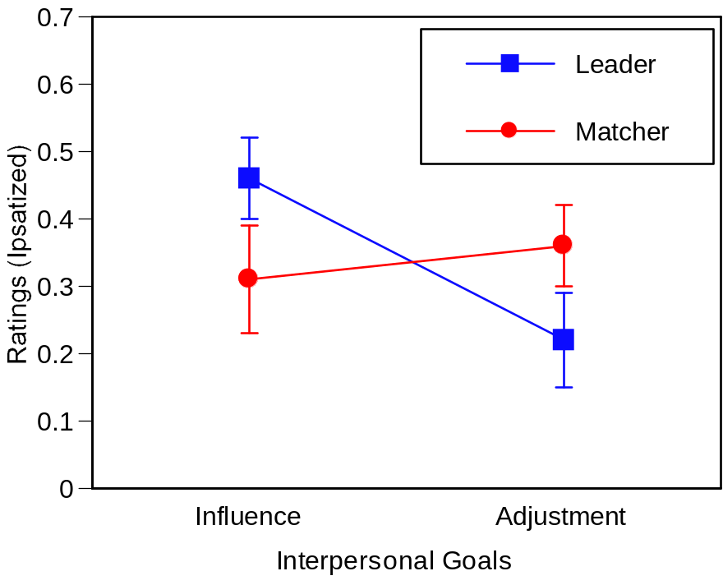
Manipulation Effectively Elicited Influence and Adjustment Goals For Females
***
**
Partner X Goal Type: F(1,47) = 26.55, p <.001
*p <.05, **p < .01, ***p < .001

Slide 6
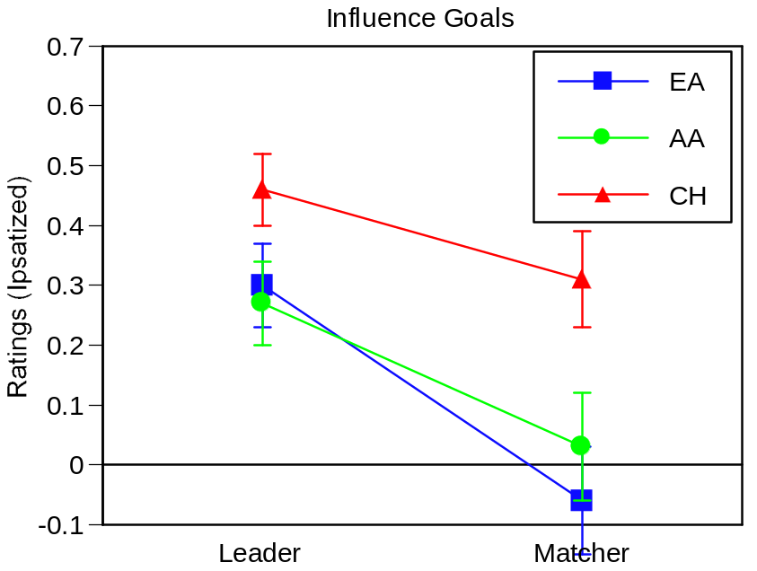
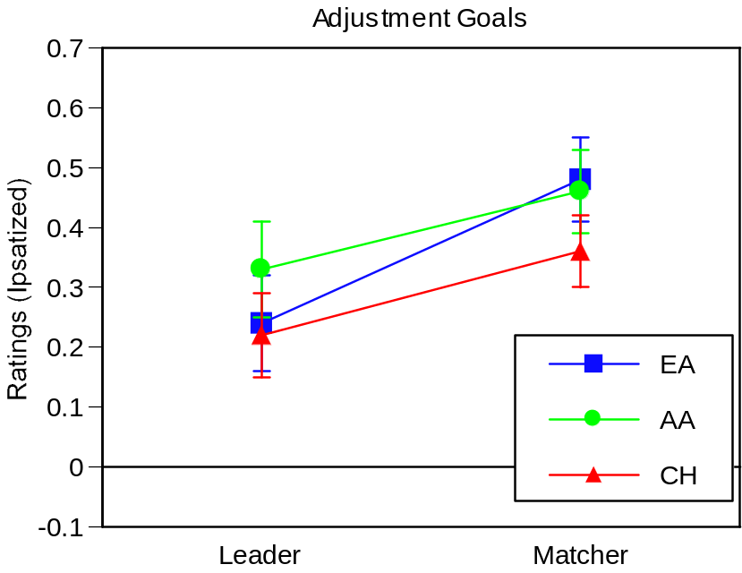
Partner: F(1,47) = 16.01, p < .001
Partner: F(1,47) = 9.05, p < .01

Slide 7
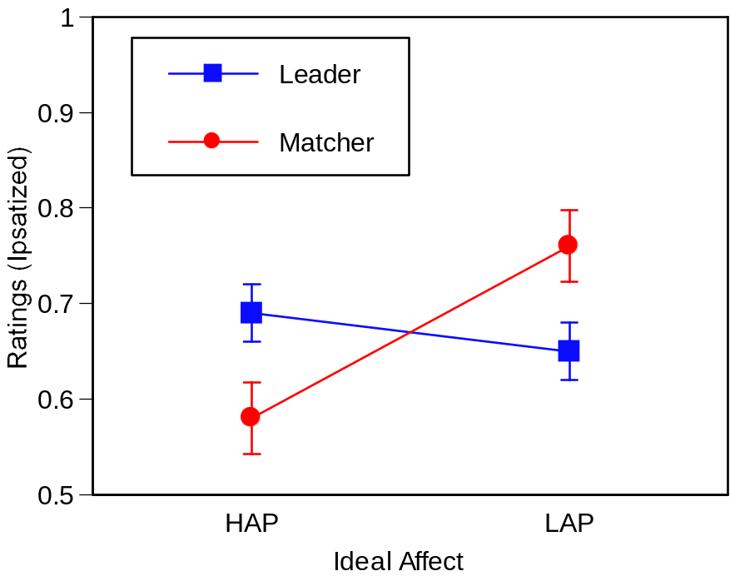
Female Leaders Value HAP More and
LAP Less Than Matchers
*
*
Partner X Affect Type: F(1,47) = 6.47, p <.05
*p <.05, **p < .01, ***p < .001

Slide 8
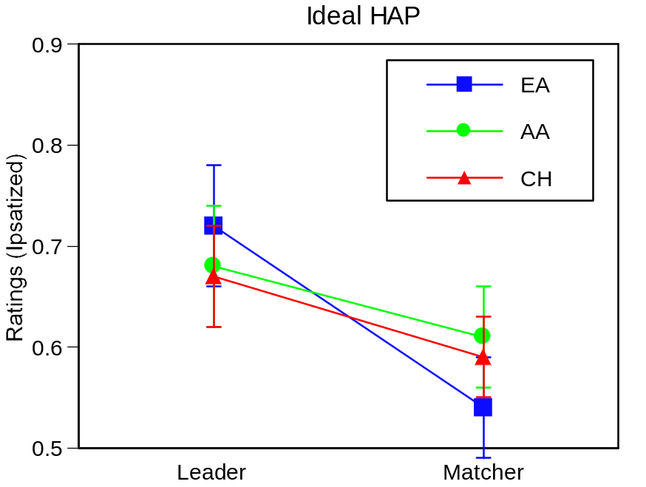
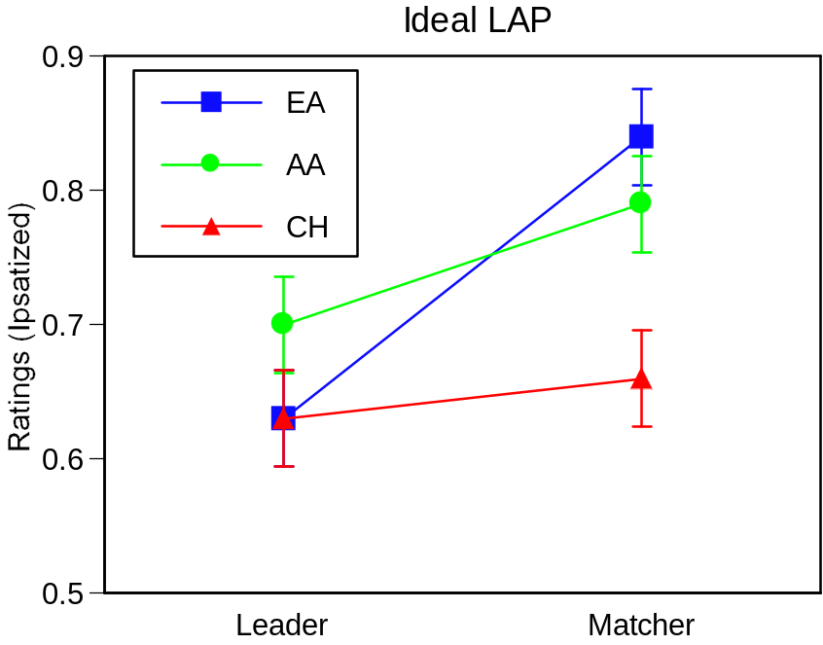
Partner: F(1,47) = 6.11, p <.05
Partner: F(1,47) = 5.81, p <.05

Slide 9
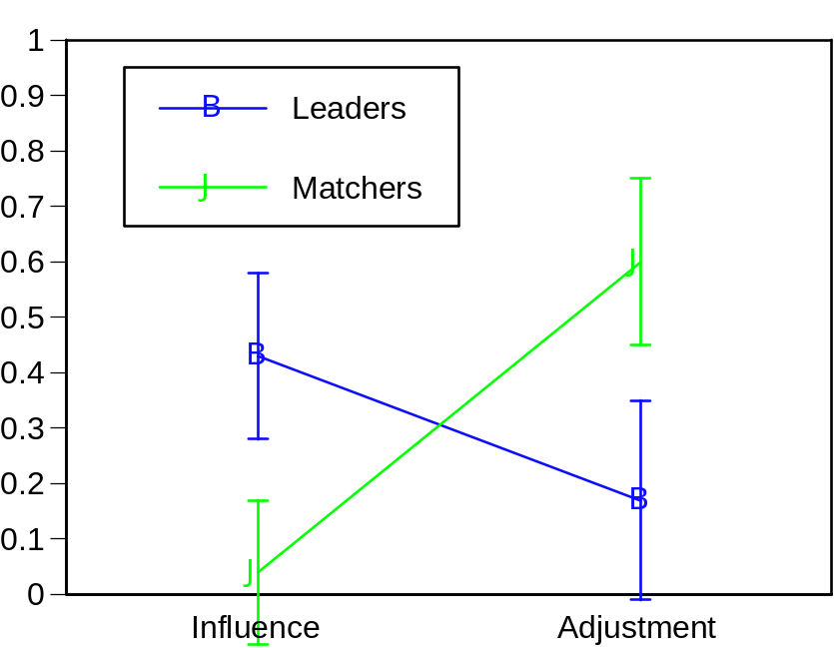
Manipulation Effectively Elicited Influence and Adjustment Goals For Males

Slide 10
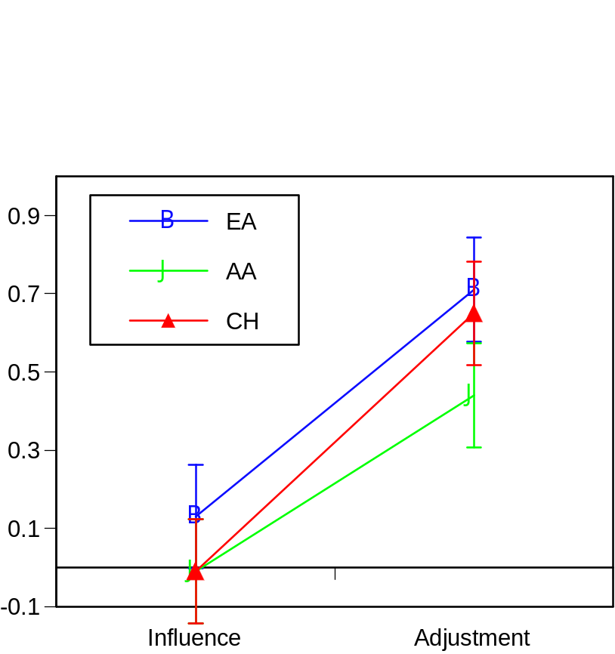
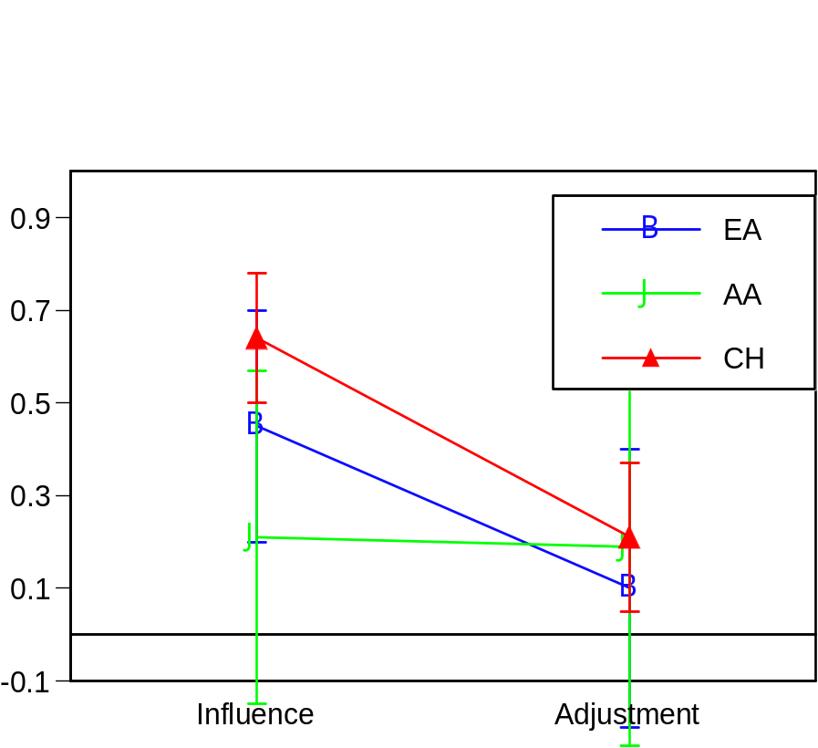

Slide 11
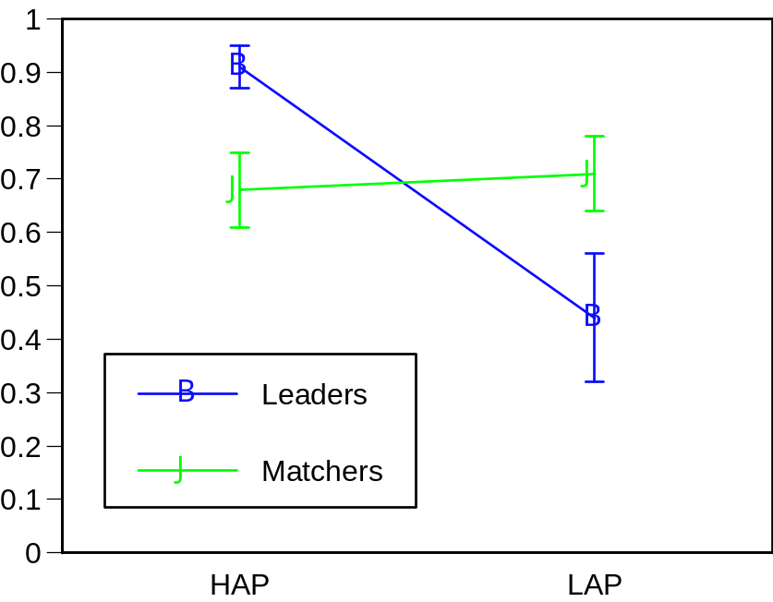
Male Leaders Value HAP and LAP Less Than Matchers

Slide 12
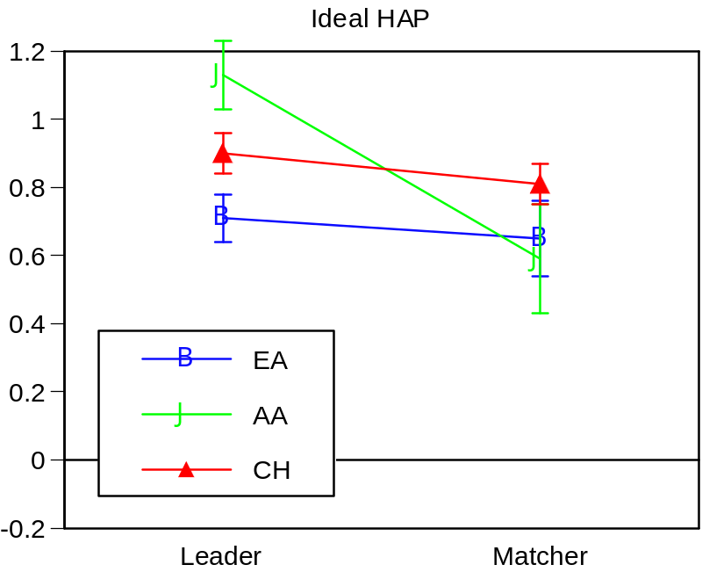
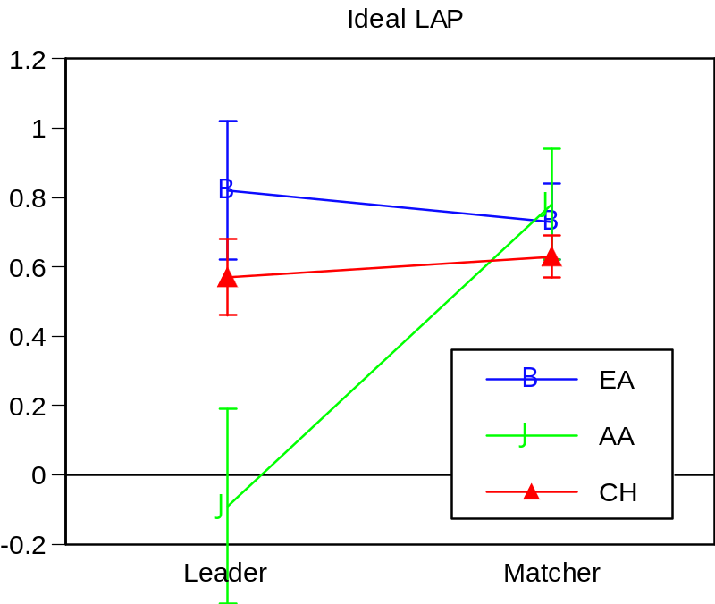

Slide 13
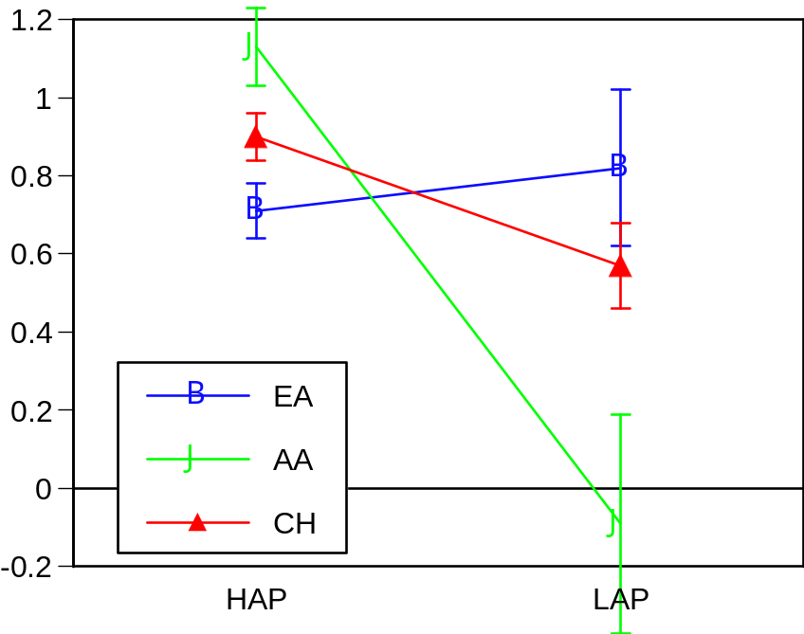
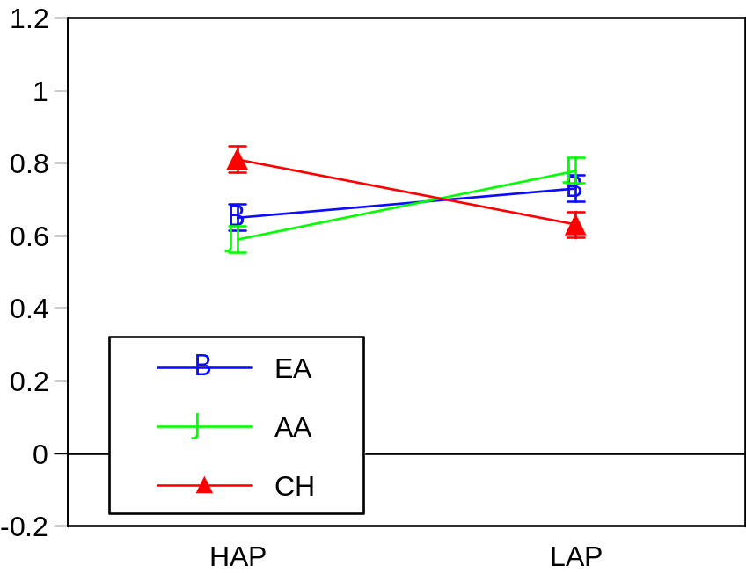
Leaders
Matchers

Slide 14
